Slide 1


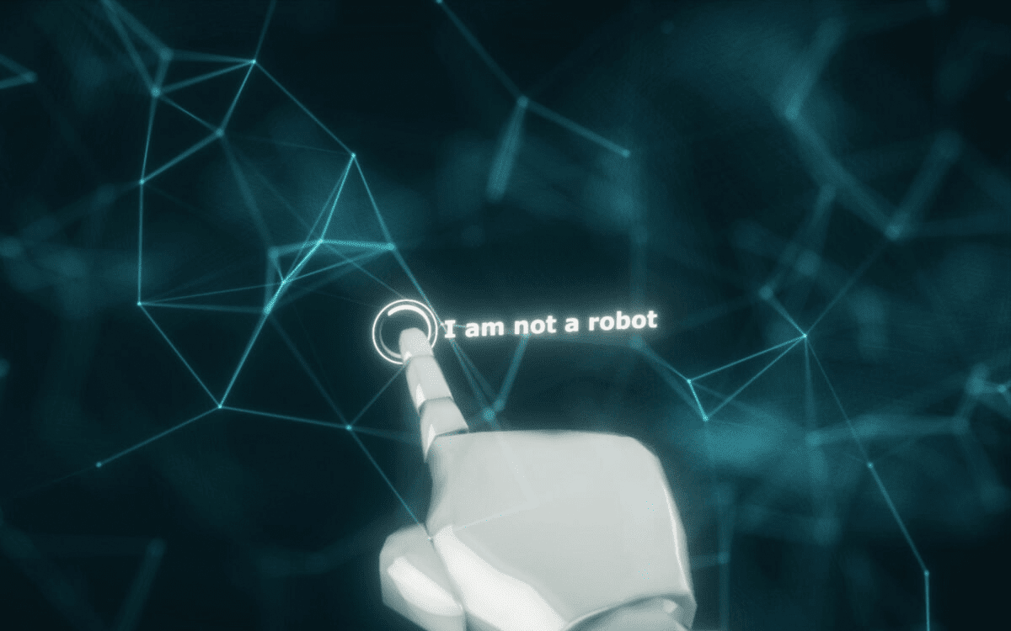
CYBER SECURITY USING CAPTCHA
Members:
Adithya B M[4GM21CS006]
Aishwarya N Surve [4GM21CS007]
Ananya N G [4GM21CS009]
Harish Rokhade[4GM21CS038]
Guide:
Prof. Kotreshi S N
Asst. Professor
Dept. of CSE
GMIT
1. CAPATCHA

Slide 2



Securing Your Website: Exploring the Benefits of Audio and Image CAPTCHAs
2.
2. CAPATCHA

Slide 3
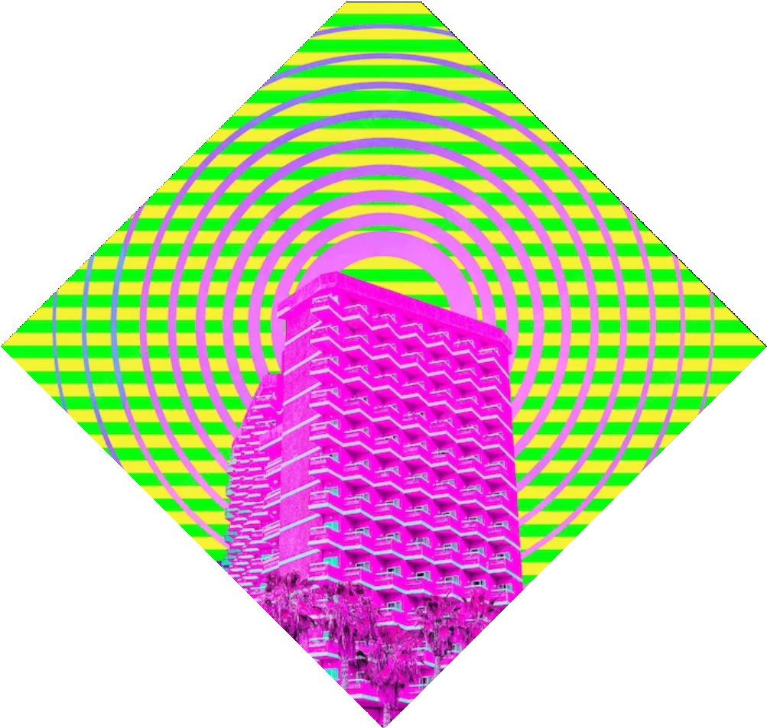
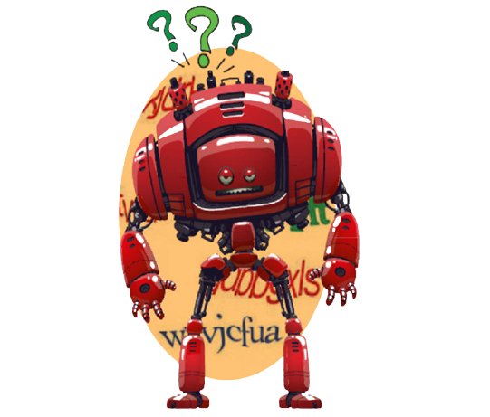
CONTENTS:
Introduction
Problem Statement
Objective
Types of Captcha
Implementation under Flowchart
Applications of Captcha
Advantages and Disadvantages
Project Exectuion
Conclusion
2. CAPATCHA
3. CAPATCHA

Slide 4



Introduction
To ensure the security of online platforms, CAPTCHA, which stands for "Completely Automated Public Turing test to tell Computers and Humans Apart," was developed.
They are used to prevent automated access to websites by requiring users to prove that they are human. CAPTCHAs can be in the form of audio, image, or text.
3.
4. CAPATCHA

Slide 5
PROBLEM STATEMENT
To create a GUI clone of college payment portal using python tkinter and securing it with the concept of audio and image captcha
5. CAPATCHA
4.

Slide 6

OBJECTIVE:
Distinguish Humans from Bots
Assist Accessibility
Protect User Accounts
Preserve Website Performance
Enhance Data Integrity
Prevent Automated Attacks
6. CAPATCHA
5

Slide 7

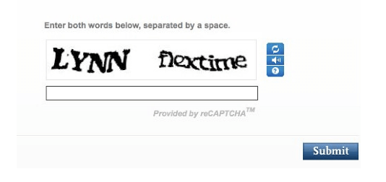
TYPES OF CAPTCHA:
Image CAPTCHA:
Users must decipher distorted or obscured text characters to prove they are human.
The text may be presented in various fonts, sizes, or orientations.
7.
7. CAPATCHA

Slide 8
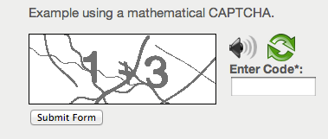
Expression CAPTCHA :
Users are asked to solve simple mathematical problems, such as addition, subtraction, or multiplication.
A straightforward challenge for humans, but difficult for automated bots.
8.
8. CAPATCHA

Slide 9

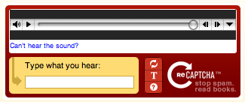
Audio CAPTCHA:
Designed to accommodate users with visual impairments.
Users listen to an audio recording and transcribe the spoken characters or words.
9.
9. CAPATCHA

Slide 10
ReCAPTCHA:
An advanced version of CAPTCHA developed by Google.
Uses machine learning to distinguish humans from bots based on their behavior on the website.
10.
10. CAPATCHA

Slide 11
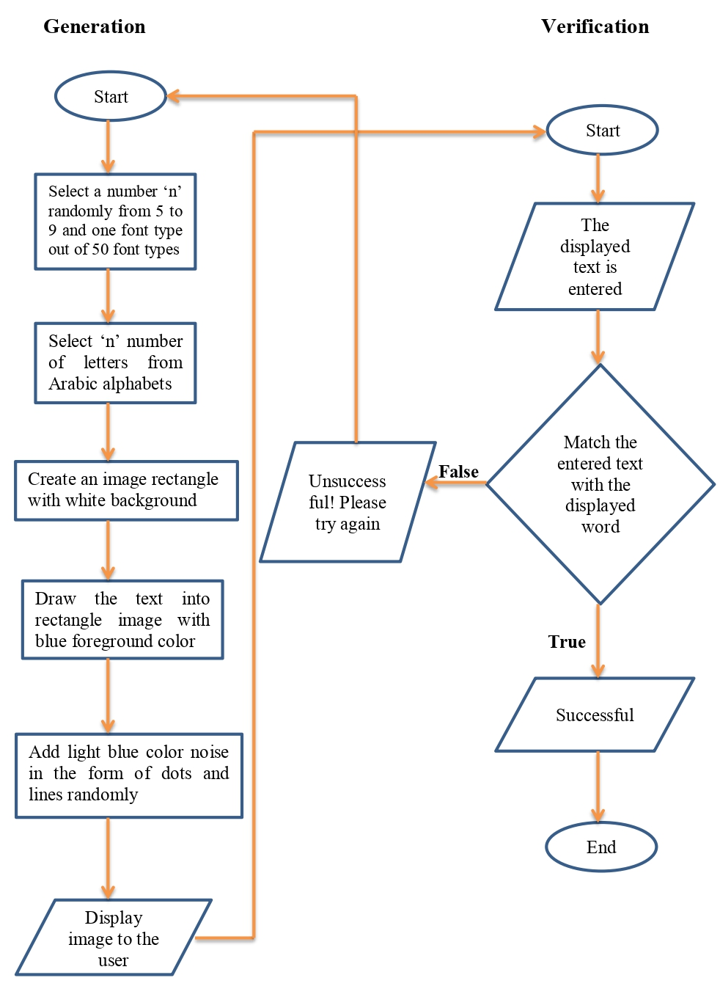
Implimentation under flowchart:
12.
11. CAPATCHA

Slide 12
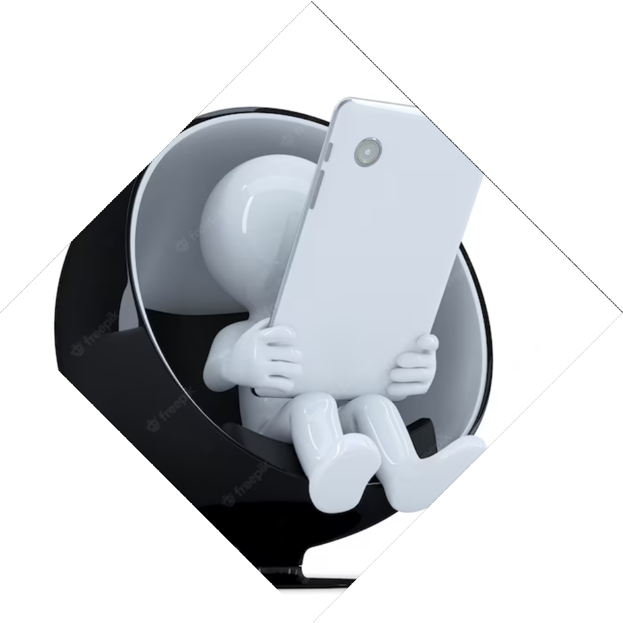
APPLICATIONS OF CAPTCHA:
User Authentication
Form Submission
Comment Sections
Account Recovery
Protection against Brute-Force Attacks
11.
12. CAPATCHA

Slide 13
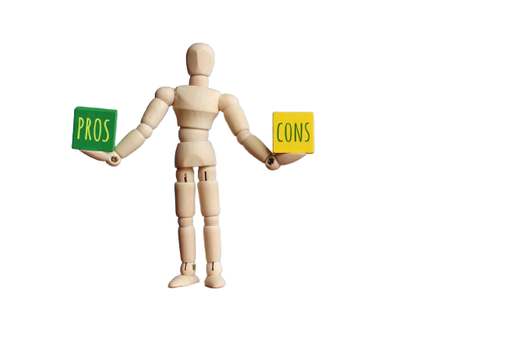
ADVANTAGES AND DISADVANTAGES :
Cons
Are not compatible with user with disabilities.
Time consuming to decipher.
Pros
Reduces spam and viruses.
Makes online shopping safer.
Makes online polls more genuine.
Distinguishes between a human and a machine.
13. CAPATCHA

Slide 14
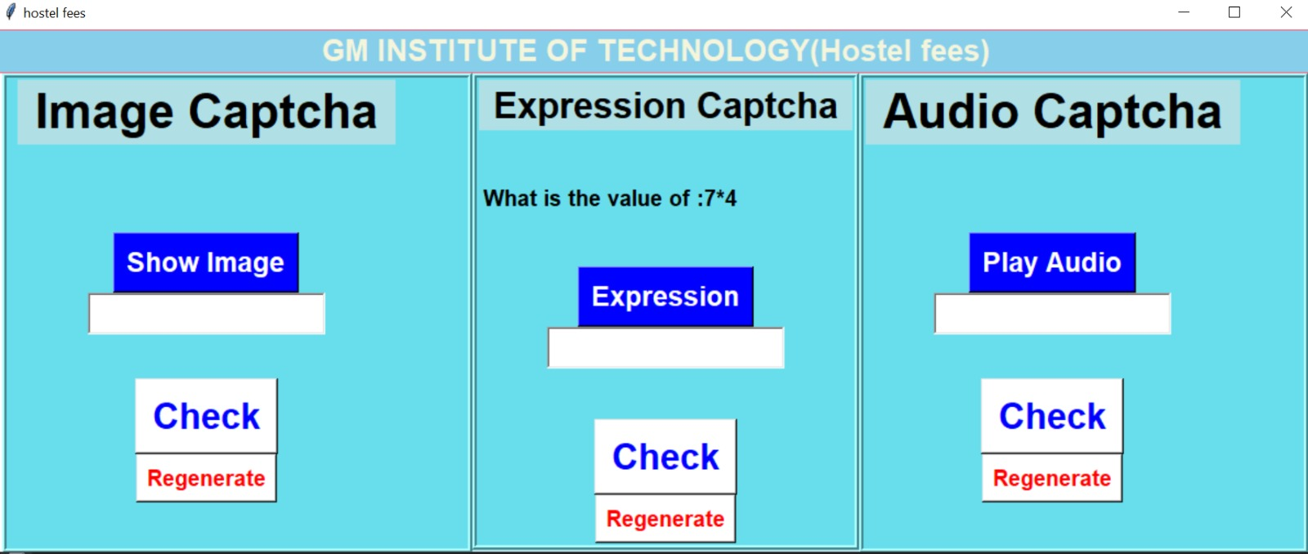
Project Execution :
Code:
https://github.com/Adithyabm2003/erp_gmit_captcha_new
14. CAPATCHA

Slide 15

Conclusion
Both audio and image CAPTCHAs have their beneﬁts and limitations. Websites should choose the type of CAPTCHA that best suits their needs and consider using alternative technologies to provide access to visually impaired users.
13.
15. CAPATCHA

Slide 16
Thanks!
Do you have any questions?
14.
16. CAPATCHA

